Slide 1
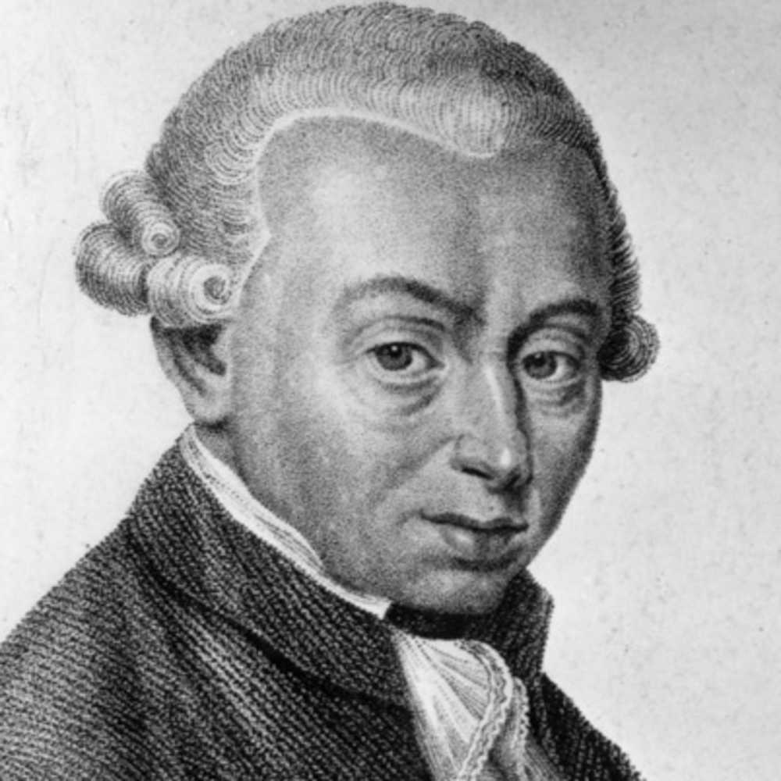
the british empiricists,
Immanuel Kant
And the march Toward skepticism

Slide 2
Agenda
British Empiricists Set the Stage
  John Locke
  George Berkeley
The Arch-skeptic David Hume ups the stakes
Immanuel Kant, the “Complacent Skeptic,” responds

Slide 3
The reaction against descartes
Followers of Descartes, notably Baruch Spinoza (1632 – 1677) and Gottfried Leibnitz (1666 – 1716), erected fantastic systems of thought removed from daily experience.
  Leibnitz proposed that the ultimate constituents of reality are Monads, tiny atoms of consciousness
  Spinoza, the only major Western Jewish Philosopher, was a pan-theist who was excommunicated from Judaism
Critique: these systems of thought rejected sense experience and simply manipulated concepts that were cut off from reality

Slide 4
empiricism
Reaction to Descartes and his followers
Empiricism holds that all knowledge is based upon the senses
  We are born tabula raza (“a blank slate”)
  Empiricists were “men of common sense concerned with life”
  Focus was on “experience”

Slide 5
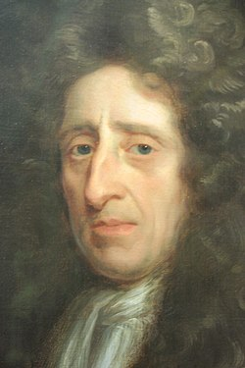
John Locke
1634 - 1704
Deeply religious physician who drew a clear line between faith and reason.
  He believed all men possess reason and must follow it.
  Held that the human mind at birth holds no innate ideas
  Essay Concerning Human Understanding
    Once we are born, we begin to fill our minds with experience
Sources of experience
  Outer: Senses
  Inner: Reflection: looking inward to the content of our consciousness

Slide 6
john Locke’s Epistemology
All our concepts are derived from “simple ideas”
  Simple ideas are provided by the senses, they are little atoms of experience
    Ex., the color green, the smell of liver and onions, etc.
  Complex ideas are made from simple ideas by
    Repetition, ex., “a dozen”
    Comparison, ex., “bigger”
    Combination, ex., white, smooth, hard combine to form “a piece of chalk”
    Abstraction, ex., separating one idea from another, ex., humans possess animality and rationality
Theory of Concepts contained skeptical element
  Believed things possess real essences, but we only know nominal essences

Slide 7
Epistemology
The Substratum
Reality only gives us certain simple ideas
We synthesize whiteness, cylindricality, hardness etc. to form “a piece of chalk”
What keeps the qualities together, what prevents them from flying off?
The Substratum
  Metaphysical glue that keeps qualities together in the form of entities
  “Something I know not what”
  Derived ultimately from Aristotle’s theory of “prime matter”

Slide 8
metaphysics
First thing we know is our own mind
  Accepts Descartes’ Cogito (“I think, therefore I am”)
Second, we know God
  By demonstration and deduction
  I exist, there must be a being that is the source of all existence
We don’t experience the material world
  Instead, we experience “ideas in our own minds”
  Material world must exist as the cause of our experience (Causal Theory of Perception)
Issue: how can an empiricist verify the existence of an unperceivable reality?

Slide 9
Ethics
Hedonism
  Psychological Hedonist
    Men and women do seek pleasure and avoid pain
  Ethical Hedonist
    Men and women should seek pleasure and avoid pain
Christianity
  Virtue is obedience to the Will of God (“In God We Trust”)
  Strong Stoic element
Rationalism
  Ethics can be derived and proven in a logical manner similar to the methods used to derive conclusions in Geometry

Slide 10

politics
Locke was the first major philosopher to offer a comprehensive, influential statement of the idea of inalienable individual rights
The Second Treatise of Government, published in 1690
  Locke argues against political absolutism, and in favor of individual rights and strictly limited government
  The Natural Law is derived from God and governs how men should deal with each other
  In a state of nature, all men and women should exist as free, independent, equal beings
    Men and women possess inalienable rights prior to the creation of any government
    Men and women are equal before the law
  Purpose of government is to secure these rights

Slide 11

politics
Social Contract
  Individuals contract with the government in order to have their rights secured.
  Individuals turn over their right to initiate the use of force to the government
    Government does not rule men and women. Instead, it is their agent
    Government legitimacy derived from the consent of the governed
  Benefits of government
    Objective laws that can be appealed to in order to resolve disputes between citizens
    A judiciary that can apply these laws in an unbiased manner
    A police force that can enforce laws and a military that can ensure the perpetuation of the social contract

Slide 12
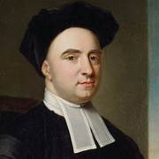
George Berkeley (1685 – 1753)
Irish Anglican Bishop, challenged the ideas of matter and an external world
  Empiricist
    All knowledge comes from experience
    No innate cognition
  Idealist
    Denies existence of an external world
    Believed universe consists of individual minds presided over by God

Slide 13
Attack on the material world
How do you or I know if I have a toothache?
Every experience of matter is similar to a tooth ache
  All we know are series of “experiences in the mind”
  In dialogues Berkeley wrote between Hylas (matter) and Philonous (mind lover), Philonous consistently wins the argument
What does it mean to say “my experience resembles reality?”
How do you know reality?
  Relies on the Causal Theory of Perception
  Attacks Representative Theory of Perception
  You only know the contents of your own mind

Slide 14

“Esse est percipi”
To Be is to be perceived
Basic argument:
  A material thing is a thing capable of being perceived, of being experienced
  From Locke, all we experience are the contents of our own minds
  Therefore, a material thing is a collection of experiences in our own minds
Matter exists only in the sense that it is perceived; esse est percipi
How can you prove that something exists if you are not perceiving it?
  If a tree falls in the forest and no one hears it, does it make a sound?
  Dr. Samuel Johnson’s kicking a stone does not refute this argument

Slide 15
The tree in the Quad
“There was a young man who said ‘God
Must find it exceedingly odd
That this tree that I see
Still continues to be
When there’s no one about in the quad’”
“’Dear sir, your astonishment’s odd
I am always about in the quad
And, thus, why this tree
Still continues to be
Since it’s perceived by, yours faithfully, God’”

Slide 16
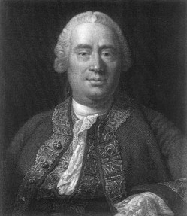
DaVid Hume (1711 – 1776)
Scottish philosopher who claimed to prove, by reason, that reason itself is impotent, invalid
Regarded by many as “The Arch-skeptic”
Became very influential among twentieth century philosophers
Bertrand Russell on Hume:
  No answer to Hume
  Hume showed, claims Russell, that there is no difference between sanity and insanity
  The man who thinks he is a poached egg is not wrong, just in the minority

Slide 17

Hume’s epistemolgy
Nominalism:
  Held that there are no real essences.
  What we call concepts are simply convenient groupings of objects
  There are no abstract ideas, only percepts
  Agreed with Hobbes that our ideas are merely fading images of percepts
  Refused to grant the validity of conceptual knowledge

Slide 18
Hume’s theory of meaning
To say something is “meaningful” means that it has a referent, that it refers to “some thing.”
“Every meaningful word or phrase must be such that you can either directly perceive its referent or form an image of its referent.”
  Ex., “desk,” “chair,” etc. all have meaning; you can perceive them
  “Unicorn” also has meaning; you can form an image of one

Slide 19
Hume’s theory of meaning
What does “external world” mean?
  The external world is distinct from our experience and continues to exist when we are no longer experiencing it.
  Hume: the idea of an “external world” continuously existing independently of our minds is meaningless
    You can’t experience something independently of your experience
    Experiencing “continuity” is meaningless

Slide 20
Hume’s theory of meaning
There are no entities
  Locke: substratum keeps qualities together
    Hume: “Substratum” is meaningless
  Berkeley: God provides mind with entities
    Hume: “God” is meaningless
There is no self
  All we experience is a shifting progression of thoughts
These thoughts are simply a constantly changing series of sense impressions

Slide 21
Hume’s theory of meaning
What do we have?
  A bundle of shifting impressions of nothing (entities, external world are myths) experienced by no one (the “self” is a myth)
Hume’s crowning achievement: the destruction of the Law of Cause and Effect
  What do we mean by necessity?
  Can you form an image of one action necessarily following from another?

Slide 22
Hume’s theory of meaning
There are no necessary connections; necessity is meaningless
  All we have are “repeated conjunctions of events”
  All events are “loose and separate”
  Because we are not circumspect in our observations of events, we invent connections that don’t exist
  Anything can happen next

Slide 23
Hume’s ethics
As one would expect, Hume’s ethics are completely subjective and skeptical
  Rational ethics are impossible
  One cannot get an “ought” from an “is”; or a “must” from an “is”
    “Reason is the slave of the passions”
    “When I give preference to an argument, I do so only from my feelings”
  Skepticism is a disease that comes from living by reason
  You must follow “irrational passions”
  We must live by our instincts that will invent the delusions we need to get through life
We cannot live by philosophy, we must be “careless and inattentive to it.”

Slide 24
Immanuel kant (1724 – 1804)
Roused from his “dogmatic slumbers” by Hume
Accepted Hume’s central premise that one cannot get “necessity” from experience
Philosophic system is ingenious and revolutionary
Widely regarded as one of the West’s major philosophers, on the level of Aristotle and Plato

Slide 25
The Critique of pure reason
Basic approach
  Two worlds
    Things as they appear (the “phenomenal world”)
    Things in themselves (the “noumenal world”)
  There are certain synthesizing structures within the human mind that, when they operate upon the noumenal world, create the world that we experience

Slide 26
The Critique of pure reason
These synthesizing structures only provide organization of content, not the content itself
  The mind itself creates necessity
  The mind does not recognize order independently of itself
Bold Hypothesis
  The mind does not discover the laws of reality
  The mind creates these laws
This is Kant’s Copernican Revolution:
  Our minds do not conform to reality
  Instead, the reality we experience, the phenomenal world (things as they appear to us), is created by the structure of our minds

Slide 27
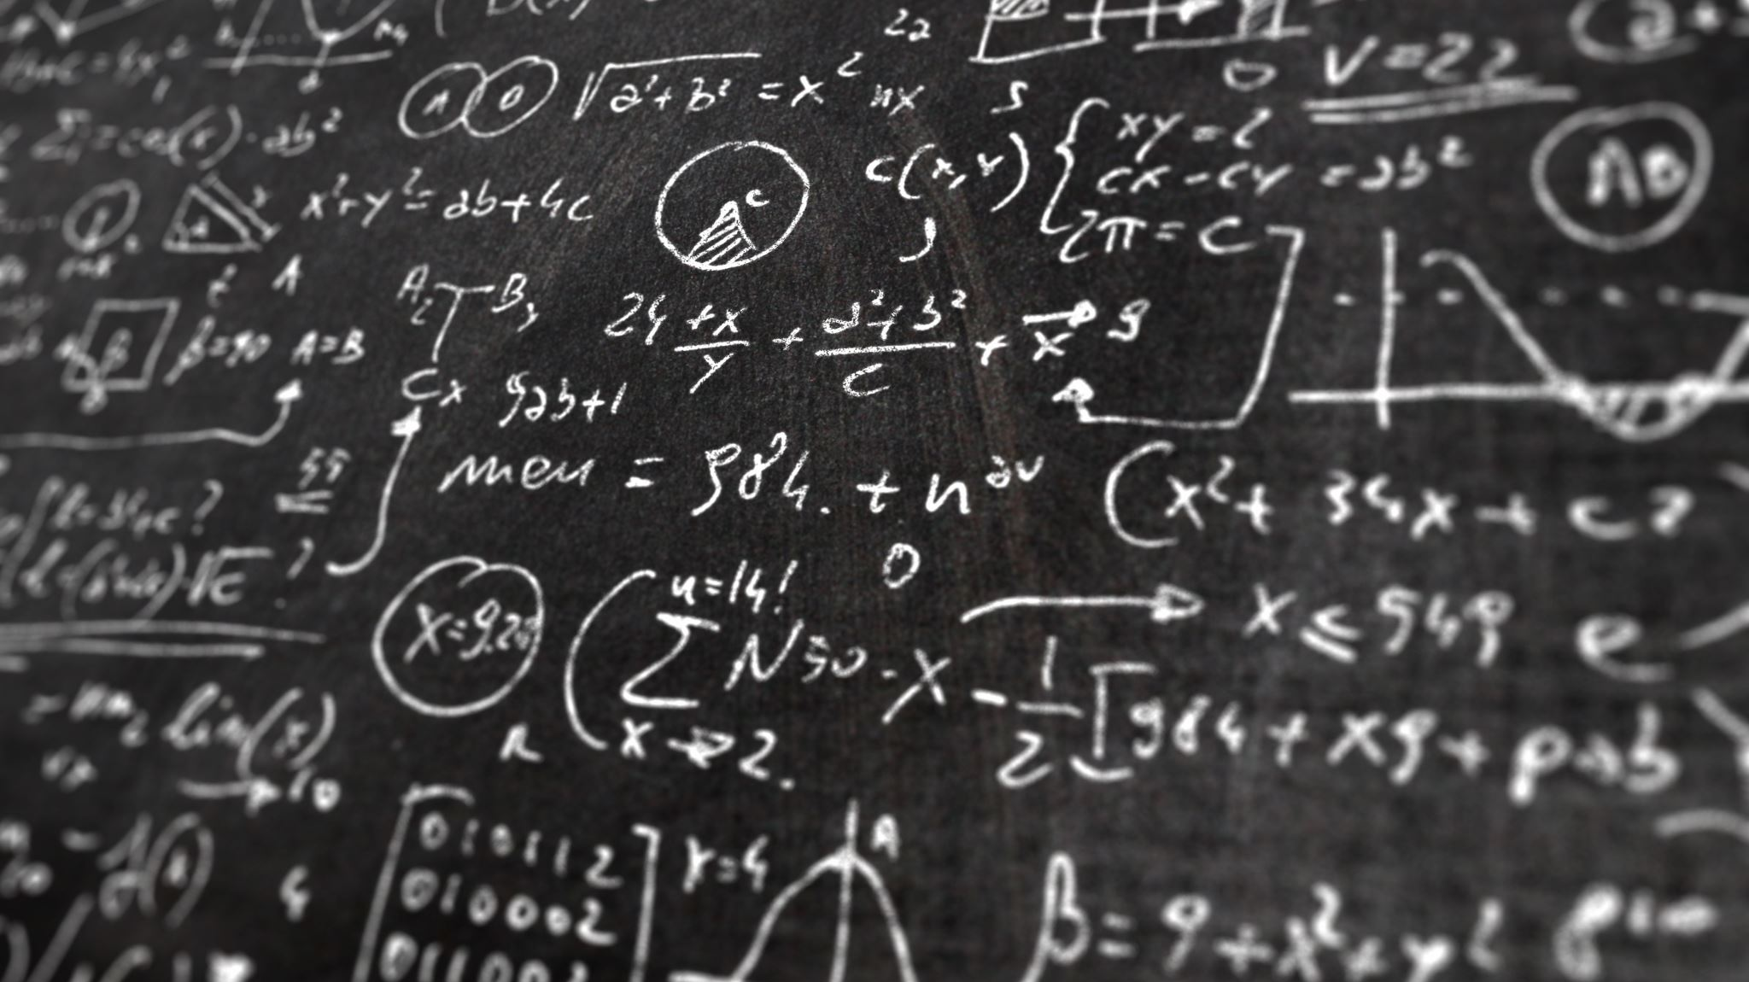
The Critique of pure reason
“It is true that all knowledge begins with experience, but it doesn’t follow that all knowledge comes out of experience”
Two necessary means of perception contributed by the mind
  Space
  Time
Because they are necessary, they must be mind-contributed

Slide 28
The Critique of pure reason
The Twelve Categories are the necessary means of conception
  Unity, Plurality, and Totality
  Reality, Negation, and Limitation
  Substance and Attribute, Cause and Effect, and Reciprocity
  Possibility, Existence, and Necessity

Slide 29
ethics
There is a phenomenal you and a noumenal you.
Thus, you are a metaphysical biped, with one foot in the phenomenal world of things as they appear and the other foot in the unknowable noumenal world of true reality
  Your noumenal self enables you to gain an insight into the proper forms of ethical behavior
  Thus, you have a sense of what you ought to do
  Certain moral commandments are built into you
The Categorical Imperative
  “Act only on that maxim whereby thou canst at the same time will that it should become a universal law.”

Slide 30
ethics
Everyone has a moral obligation to help others
Kant was not concerned about consequences
You must obey the Categorical Imperative because it is dictated by the structure of your mind
“Morality is its own reward”
  One must act from duty, not from inclination
  If they point in the same direction, then there is no moral worth accruing to the action!

Slide 31

Thanks for attending!
We hope you enjoyed this presentation.

